Slide 1
AVL Tree
Pelatnas 2 TOKI 2015
Arianto Wibowo

Slide 2
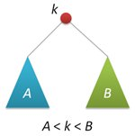
AVL Tree
Butuh data apa aja??
struct node {
int key;
int height;
node *left;
node *right;
node (int k){key=k; left=right=0; height=1;
}

Slide 3




Rotation

Slide 4
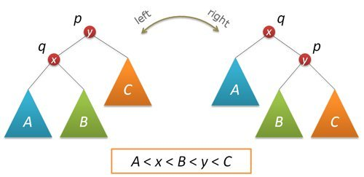
Rotation
node* rotateright(node* p) { node* q = p->left; p->left = q->right; q->right = p; fixheight(p); fixheight(q); return q; }
node* rotateleft(node* q) { node* p = q->right; q->right = p->left; p->left = q; fixheight(q); fixheight(p); return p; }

Slide 5
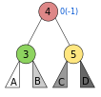
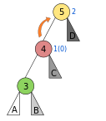
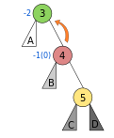
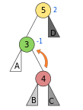

When Rotation Used??

Slide 6
How to Detect that Single/Double Rotation Needed?
node* balance(node* p) { fixheight(p); if( bfactor(p)==2 ) { if( bfactor(p->right) < 0 ) p->right = rotateright(p->right); return rotateleft(p); } if( bfactor(p)==-2 ) { if( bfactor(p->left) > 0 ) p->left = rotateleft(p->left); return rotateright(p); } return p; }

Slide 7
Insertion
Easy kan? OK…next

Slide 8
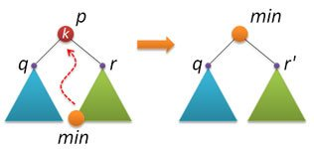
Deletion
Jangan lupa dibalance lagi yaa !!

Slide 9

Sorry for the long post Here’s a potato + tree for you

